Slide 1

Transparent Political Donations in Canada
Laura Anthony
Research Analyst
December 6th 2014

Slide 2
IN THIS PRESENTATION
What is Samara?
The Problem
The Data
Three Questions
1
2
3
4
Notes:
Lay out agenda for presentation.

Slide 3
WHAT’S SAMARA?
Samara is a non-partisan charitable organization that works to improve political participation in Canada.

Slide 4
WHY IS SAMARA NEEDED?
Voter turnout has been decreasing for the past 20 years
So have many other forms of political participation
Being a party member
Donating to a political party
Volunteering on an election campaign
Canadians are unsatisfied with the performance of Members of
Parliament and political parties. They sense a disconnect with
their elected representatives.
Samara seeks to reconnect citizens to the political process

Slide 5
WHAT DO WE DO?
1. RESEARCH
Helps us identify problems with Canada’s political system and propose solutions
Explore and expose how Canada’s democracy works in accessible and innovative way
Help Canadians to better understand and contribute to renewing politics
2. ENGAGEMENT
Democracy Talks
Facilitated conversation which encourages Canadians to develop their political voice
Everyday Political Citizen
Celebrates the unsung heroes of Canadian democracy by highlighting the regular
People who are making their communities better every day.

Slide 6
THE PROBLEM: POLITICAL CONTRIBUTIONS
In 2012, approximately $35 million in donations given to the national party
With over 1200 riding associations in Canada, there’s no easy way to calculate total number of donations (we guess about $2.6 million)
ALL political donations over $200 are subject to generous tax credits
That means millions of public dollars are flowing in the system
Samara’s calculation: $45.3 million tax dollars in 2012
Only going to increase in importance given the elimination of the per vote subsidy for political parties
Notes:
Overall we know VERY little about political party finance in Canada
One component of this is how individuals donate to political parties

Slide 7
THE PROBLEM: POLITICAL PARTY DONATIONS
1
National Political Party (max $1,200)
2
Riding Association (max $1,200)
POTENTIAL TOTAL: $2,400 per year
Notes:
Overall we know VERY little about political party finance in Canada
One component of this is how individuals donate to political parties

Slide 8
THE PROBLEM: WHY YOU’RE HERE TODAY
No comprehensive picture of political donors or donations in Canada

Slide 9
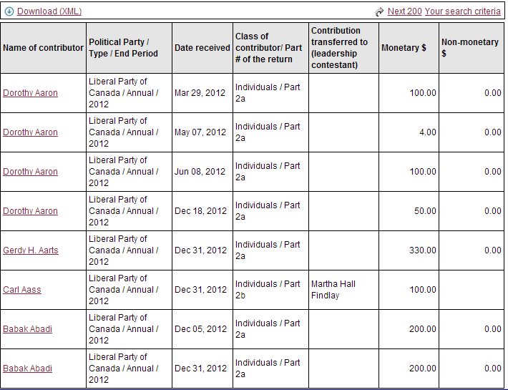
THE PROBLEM:THE ORIGINAL DATA
$254

Slide 10
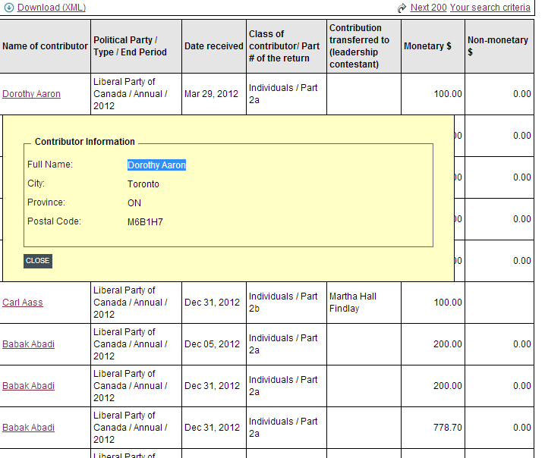
THE PROBLEM: THE ORIGINAL DATA

Slide 11
WHAT WE’VE DONE (SO FAR)
Combined and Cleaned all the data for 9 years!
Thanks to Leon! And Star Treck (I’ll let him explain)

Slide 12
THE DATA: WHAT WE KNOW
Years: 2004-2013
5 political parties (LPC, CPC, NDP, GPC, BQ)
Donation Target
Political Party
National Party
EDA
Contributor’s First and Last Name
Date of Contribution (Day, Month, Year)
Size of Donation
Contributor’s City
Contributor’s Province
Contributor’s Postal Code

Slide 13
THREE QUESTIONS
1
Understanding the Data – Frequencies and Visualization
2
Merging Other Data Sets – What other sources can be added to strengthen the data?
3
Outliers in the Data + Making the Data Shareable

Slide 14
1. Understanding the Data
Tax Credits
- How much public money pumped into the system each year?
Regional Variation
- What’s the highest donating city/province?
- Per captia?
Party Differences
- Leading up to 2015, what are each party’s trends?
- How many people donate to 1 party? 2? 3? 4?
Frequency
How many people donate one lump sum every year?
How many donate every month?
Structure
- How many people donating at both levels?
- Number of donors inside and outside of the riding?

Slide 15
2. Merging Additional Datasets
What other publically available information can be merged with this data set?
Census Information (by postal code)
Voter Turnout (by riding)
Other publically available information? (you know better than us!)

Slide 16
3. Finding Outliers + Sharing Data
What are the outliers in the data?
Abnormal postal codes?
Dense concentration of donation in particular geographic areas?
Donations over the limit?
Making the Data Accessible
What is the best way we can store this information and make it easy for others to use?
How can we make it very acccessible?

Slide 17
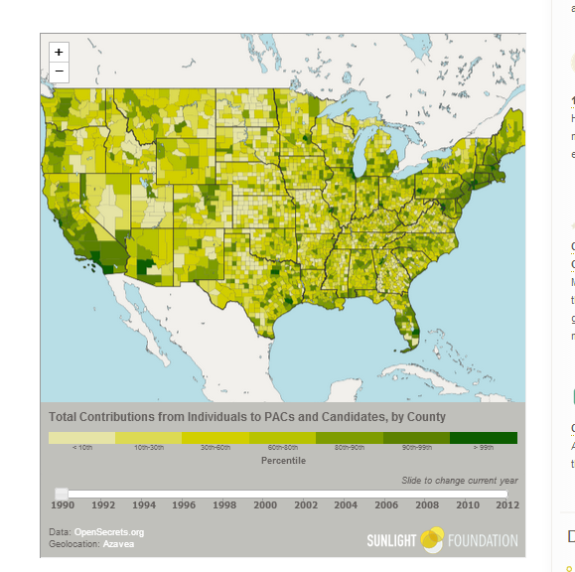
THE SOLUTION: END PRODUCT (?)
http://sunlightfoundation.com/blog/2013/10/23/political-influence-by-county-a-new-way-to-look-at-campaign-finance-data/

